Slide 1
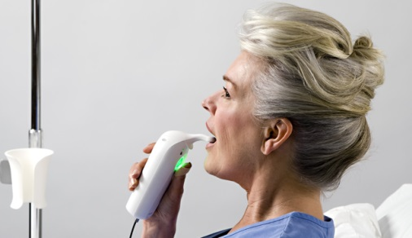
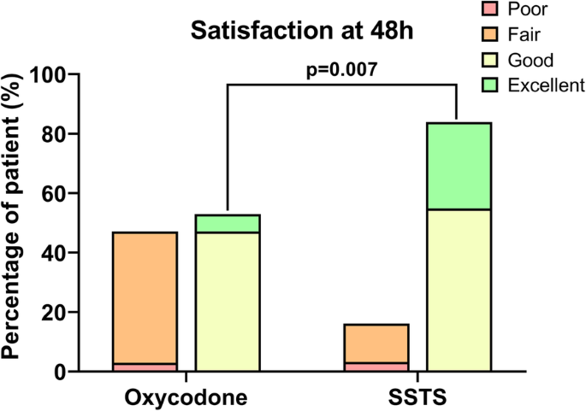
Sublingual Sufentanil Tablet System (SSTS) PCA - PCA but not as you know it!
Who? - Post operative patients that are expected to experience severe to moderate post operative pain (Porela-Tiihonen, Kokki, & Kokki 2017). - Patients ordered this therapy need to have good cognition, vision and use of their hands to safely operate the system, in addition to being hemodynamically appropriate (Van de Donk et al 2018). What? - Sufentanil is a potent synthetic μ receptor-specific agonist which is mainly used for intraoperative surgical analgesia via intravenous or intrathecal routes (Noel et al 2020). - This sublingual sufentanil has been formulated in this case, to provide patients with post operative pain relief. - Sublingual nanotablet PCA transmucosal bioavailability is 59% and the meaningful analgesic onset time is 60 minutes (Porela-Tiihonen, Kokki, & Kokki 2017). - As seen in the table on the left, the SSTS PCA system when compared to oxycodone (usually gained by asking a nurse) satisfaction rates were higher (Noel et al 2020). Where? - Where initial post operative care is given, e.g. post op surgical ward. -The device can be commenced in recovery to assess if patient is able to operate, if not this should be delayed until the patient is able to receive the appropriate education (Porela-Tiihonen, Kokki, & Kokki 2017).
When? - Study's have mainly focused on the 72 hours post operatively for patients, however It should be carefully assessed and deemed appropriate by the medical/surgical or specialised pain team to cease the device order. How? - The device suspends a 15 µg nanotablet when prompted by the patient, followed by a fixed 20min lockout interval that has been pre programmed into the device. - The device has the option to be secured to the bed, facial recognition, and added safety features for the attending staff (Van de Donk et al 2018).
Why and what to consider for clinical practice? - The device contains 40 sublingual 15-μg sufentanil micro-tablets In a cartridge = less time spent replenishing supply (Porela-Tiihonen, Kokki, & Kokki 2017). - Non invasive (in comparison to the commonly used intravenous route) - Self administration, empowering patients to take control of their pain relief and recovery. - Study's show quicker rehabilitation, enabling early mobilization post operatively, bettering their post op recovery (Van de Donk et al 2018). - Only one lockout time available, therefore not suitable to all patients and potency may be too high (Van de Donk et al 2018). - Post operative patient observation and monitoring are the same for the sufentanil sublingual tablet system as for any postoperative patient on strong opioid medication (Van de Donk et al 2018).
References Noel, E, Miglionico, L, Leclercq, M, Jennart, H, Fils, JF and Van Rompaey, N, 2020. Sufentanil sublingual tablet system versus oral oxycodone for management of postoperative pain in enhanced recovery after surgery pathway for total knee arthroplasty: a randomized controlled study. Journal of Experimental Orthopaedics, vol. 7, no. 1, pp.1-8.
Porela-Tiihonen, S, Kokki, M & Kokki, H, 2017. Sufentanil sublingual formulation for the treatment of acute, moderate to severe postoperative pain in adult patients. Expert review of neurotherapeutics, vol. 17, no. 2, pp.101-111.
Van de Donk, T, Ward, S, Langford, R & Dahan, A, 2018. Pharmacokinetics and pharmacodynamics of sublingual sufentanil for postoperative pain management. Anaesthesia, vol. 72, no. 2, pp.231-237.

